Slide 1
Open Source Projects
Prof. Dr. Dirk Riehle
Friedrich-Alexander University Erlangen-Nürnberg
COSS D01
Licensed under CC BY 4.0 International
Notes:
It is Friedrich-Alexander University Erlangen-Nürnberg – FAU, in short.
Corporate identity wants us to say “Friedrich-Alexander University”.

Slide 2
Agenda
Process definition (open source)
Project communities
Developer-led foundations
User-led foundations
Labor economics
Example governance models
Project life-cycle

Slide 3
1. What is an Open Source Project?

Slide 4
The Other Definition of Open Source
“Open source is a development method for software that harnesses the power of distributed peer review and transparency of process. The promise of open source is better quality, higher reliability, more flexibility, lower cost, and an end to predatory vendor lock-in.” [O10]

Slide 5
The Cathedral and the Bazaar [R99]
The Cathedral
  Carefully crafted work
    Performed by small group
    Evolves slowly
  Bugs and problems are tricky,
  require deep analysis
  Project is led by command and control approach
  No early releases nor beta
The Bazaar
  Incremental work
    Performed by large group
    Evolves rapidly
  Linus’ law: “Given enough eyeballs,
  all bugs are shallow”
  Project is lead by convincing people, nudging them on
  “Release early, release often”

Slide 6

The Linux Kernel and the Linux Foundation
The Linux kernel
  Is an operating system kernel
  Was originally developed by Linus Torvalds
  Has a hierarchical development model (BDFL)
The Linux Foundation
  Is a U.S.-based 501(c)(6) foundation
  Was founded to protect and stabilize Linux
  Is now a major home for new open source initiatives

Slide 7
The Apache Way
Official [A10b]
  Collaborative software development
  Commercial-friendly standard license
  Consistently high quality software
  Respectful, honest, technical interaction
  Faithful implementation of standards
  Security as a mandatory feature
Curcuru [C17]
  Charity
  Community
  Consensus
  Merit
  Open
  Pragmatic

Slide 8

A “Patchy” Web Server and the ASF
The Apache Web Server
  is the most widely used http demon (> 50% market share)
  gave rise to a new development model, codified as the Apache way
The Apache Software Foundation
  Is a 501(c)(3) foundation “in the public interest”
  Was founded to stabilize and protect the Apache open source software

Slide 9
Open Collaboration [R+09]
Open Collaboration
  Egalitarian
    Open for contribution
    Everyone can contribute
  Meritocratic
    Public discussion process
    Decisions based on merit
  Self-organizing
    People find their process
    People find their project
Traditional Work
  Hierarchical
    Closed and hidden silos
    Assigned to project
  Status-based
    Public + private discussions
    Hierarchical status decides
  Assigned tasks
    Prescribed process
    Prescribed jobs

Slide 10
Open Source Project (= People + Software)
An open source project is
  Not a project but rather a piece of software
  Provided under an open source license
  Developed by a community of people
  Using the principles of open collaboration
A community of people here is a
  Group of people independent of each other
  That relate to and collaborate with each other
  For a shared common goal of the software
Apache’s definition of independence
  At least from three different legal entities
  Legal entities = {juristic person, natural person}
  Called committer diversity

Slide 11
2. Project Communities

Slide 12
Open Source Project Community
An open source project community is
  The group of people and companies engaged in an open source project
The developer community is
  The subset of the project community that is developing the software
The user community is
  The subset of the project community that is using the software

Slide 13
The Basic Career Path [R15a]
Has commit (write) rights
Performs bulk of the work, patch review
Committer
explicit promotion
Provides small features, bug fixes
Submits patches (no commit right)
Contributor
implicit promotion
Knows and uses software
If so, helps with comments, feedback
User
[1] Committers are called “maintainer” (mostly in the Linux context)

Slide 14
The Onion Model [CH11]
1. Reader
2. Passive user
3. Bug reporter
4. Bug fixer
5. Peripheral developer
6. Active developer
7. Core member
8. Project leader
User
Contributor
Committer

Slide 15
Roles and Posts in Open Source Projects
PM
EM
SD
ST
Roles
Posts
Committer
Contributor
User

Slide 16
Product Management in Open Source
Strategic product management
  Does not take place in open source
Technical product management
  Product roadmapping
    Some is performed but often is ad-hoc
  Product specifications
    Barely exist as documents (wikis, to-do lists, other)
  Progress tracking
    Managed by time, it is done when it is done

Slide 17
Engineering Management in Open Source
Release planning
  See product management: Some is performed but often is ad-hoc
Resource allocation
  Committers can prod contributors
  Usually contributors pick up what they like to work on
Process improvement
  Ad-hoc, if any

Slide 18
Software Development in Open Source
Programming
  Like in closed source, but in general with less visibility as to completion

Slide 19
Quality Assurance in Open Source
Code review
  Is the core ingrained best practice followed by open source projects
Automated testing
  Like in closed source, though perhaps a bit more ad-hoc in general
Manual testing
  A lot of user testing, significantly more than in closed source
Release management
  Like in closed source, committers play release manager

Slide 20
Governance
Governance is
  The set of processes, practices, institutions, and roles used to lead and manage a social system

Slide 21
Governance Models
The BDFL (“benevolent dictator for life”)
The peer group (cf. Apache)
The do-ocracy

Slide 22
Work on the Linux Kernel 2.6.20
“At least 65% of the code which went into 2.6.20 was created by people working for companies.” [C07]

Slide 23
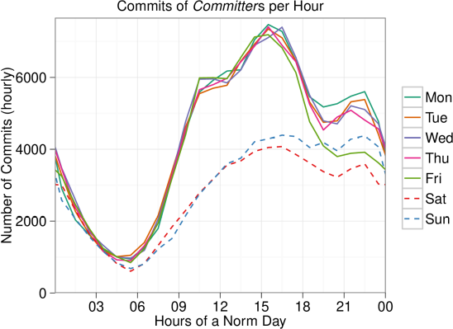
Daily and Weekly Work in Open Source Projects [R+14]

Slide 24
3. Developer-led Foundations

Slide 25
Developer-led Open Source Foundations (Recap)
An developer-led open source foundation is
  a non-profit organization (foundation, consortium)
  with the purpose of managing and performing the development of
  non-differentiating open source software
  made available to foundation members and the general public
Typical members of a developer-led foundation are
  Individual developers
  Software vendors
  Service providers
  Consulting firms

Slide 26
Motivation for Developer-led Foundations (Recap)
Support and protect people and their projects
  Protect developers from lawsuits
  Accept donations; manage books
  Legally represent project interests
Create a stronger more competitive ecosystem
  Increase share of customer wallet
  Reach more price-sensitive customers
  Grow addressable market
Create a fair and equal playing field for members
  Regulate access to intellectual property
  Regulate access to marketing channels
  Regulate product roadmap and development

Slide 27
Solutions to Abuse of Relevant Property Ownership
The foundation becomes the owner of all relevant (“chokepoint”) properties
  Re: copyright
    The foundation acquires copyright via contributor license agreement
    The foundation licenses out using an agreed-upon open source license
  Re: patent rights
    The foundation chooses an open source license with a patent usage rights grant
    The foundation arranges for a FRAND [1] patent usage rights grant (uncommon)
  Re: trademark rights
    The foundation acquires all necessary trademark rights
    The foundation clarifies access to and usage rights of trademarks
  Re: other properties (e.g. domain names)
    The foundation acquires them and handles them appropriately
[1] FRAND = “fair, reasonable, and non-discriminatory”

Slide 28
Solutions to Abuse of Control of Position of Power
The foundation defines governance processes that resolve project strife
  Re: social leadership
    The foundation sets-up appropriate processes to avoid strife in the first place
    If necessary, the foundation can still step in if project leaders misbehave
  Re: committer rights
    See abuse of social leadership

Slide 29
The Extended (Foundation) Open Source Career Path
Committer
Foundation
member
explicit promotion
explicit promotion
Contributor
Project Management Committee leader
implicit promotion
explicit promotion
User
Project Management
Committee member

Slide 30
Tasks and Purpose of New Positions
Has interest of foundation at heart
Acts as coach, markets, represents
Engages in internal discussions
Foundation
Member
explicit promotion
Leads project management committee
Coordinates with other PMCs
Steers industry platform
Project Management Committee leader
explicit promotion
Contributes to project management
Helps steer industry platform
Often (not always) active in project
Project Management Committee member
from committer

Slide 31
Types of Open Source Foundations (Recap)
Open source
foundation
Developer-led
foundation
Community-led
foundation
Vendor-led
foundation
User-led
foundation
e.g. Apache Software Foundation
e.g. Linux Foundation
e.g. Kuali Foundation

Slide 32
Dysfunctions of Vendor-led Foundations
Misuse of projects as marketing channels
Special provisions in bylaws for ensuring influence

Slide 33
4. User-led Foundations

Slide 34
User-led Open Source Foundation (Consortium)
A user-led open source consortium is
  a non-profit organization (foundation, consortium)
  with the purpose of funding and managing the development of
  non-differentiating open source software
  made available to foundation members and the general public
Typical members of a user foundation are
  Software user firms
  Software vendors
  Consulting firms
  Service suppliers

Slide 35
























Example User-led Foundations

Slide 36
Purpose of a User-led Foundation
To get rid of or reduce the problems of vendor lock-in
  High total cost of ownership
  Innovation blockage
  Operational risk
By establishing a supplier ecosystem
  For software products and services that
  Is based on community open source software and
  Conforms to the economics of the sponsors

Slide 37
Software and Services Ecosystem of Suppliers
Product /
vendor 1
Product /
vendor 2
…
Product /
vendor n
Commercial
products and services
Community open
source software
Community open source platform

Slide 38













The Next Billion Dollar Opportunity

Slide 39
5. Labor Economics

Slide 40
Position in Project = Status (Recap)
Committer
Foundation
member
explicit promotion
explicit promotion
Contributor
Project Management Committee leader
implicit promotion
explicit promotion
User
Project Management
Committee member

Slide 41
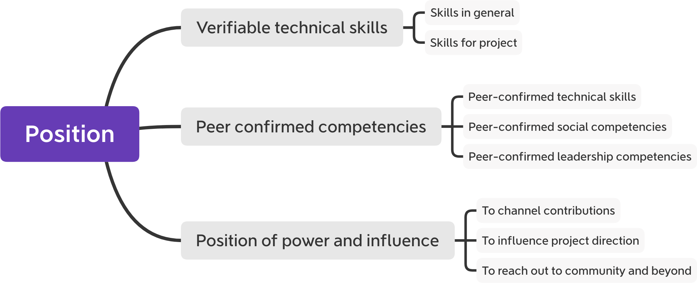
Value of Status in Open Source Project to Employers

Slide 42
Resulting Value to Developer
Better negotiation position
Higher job security
Richer job experience

Slide 43
The Developer Labor Market
A weaker position towards an employer
  Because of more competition in general
A stronger position towards an employer
  If can get a coveted open source position

Slide 44
6. Example Governance Models

Slide 45
Illustration of the Code Architecture of the Linux Kernel
Kernel
Base
Networking
Device Driver
Memory Manage-ment
...
SCSI Driver
Graphics Driver
USB Driver
...

Slide 46
The BDFL Model or Conway’s Law Applied
Linus
Torvalds
Kernel
Base
David S.
Miller
Greg Kroah- Hartman
Balbir
Singh
Networking
Device Driver
Memory Management
...
Dario
Ballabio
Dave
Airlie
Li Yang
...
SCSI Driver
Graphics Driver
USB Driver

Slide 47

Engineering Management in PostgreSQL
Core team (long-term stable six members)
  Coordinate release management activities
  Facilitate consensus building process
  Decide if community consensus fails
  Administer major assets (website, repository)
20+ major contributors (committers)
  Have commit rights, contribute to code base
(Regular) contributors
  Contribute to code base through committers
“Hacker Emeritus” and past contributors

Slide 48
Product Management in PostgreSQL
Product roadmap is defined by core team [2]
Product backlog is maintained as a to-do list
There is no prioritization: “Pick your feature”
Community uses user polls for market research
[1] http://www.postgresql.org/developer
[2] http://www.postgresql.org/developer/roadmap
[3] http://wiki.postgresql.org/wiki/Todo

Slide 49
Tiki’s Do-ocracy
Tiki has a plug-in based software architecture
Everyone gets access (upon request)
Has strong code ownership
SD
SD
SD
Tiki
code
SD
SD
SD
SD
SD

Slide 50
An Example of “Just Good Enough”
bug count
frequency of feature use

Slide 51
Three Different Governance Models
The BDFL Model
  Hierarchical with strong code ownership
  Example: The Linux kernel
The Peer Group model
  Core group of committers and evangelists
  Example: The PostgreSQL RDBMS
The Do-ocracy
  Those who do, rule
  Example: Tiki Wiki CMS Groupware

Slide 52
7. Project Life-cycles

Slide 53
Life-cycle of Open Source Projects (Similar to Products)
maturity
growth
decline
birth
death
time

Slide 54
Innovation and Commoditization
Innovation frontier
Commercial +
community distributions
Single-vendor commercial + community
projects
Distributions
Commoditization frontier
Community
distributions
Community
projects
Single products

Slide 55
Summary
Process definition (open source)
Project communities
Developer-led foundations
User-led foundations
Labor economics
Example governance models
Project life-cycle

Slide 56
Thank you! Questions?
dirk.riehle@fau.de – http://osr.cs.fau.de
dirk@riehle.org – http://dirkriehle.com – @dirkriehle
DR

Slide 57
Credits and License
Original version
  © 2020 Dirk Riehle, some rights reserved
  Licensed under Creative Commons Attribution 4.0 International License
Contributions
  None yet

